Slide 1
Introduction to databases and SQL
Ameria bank

Slide 2
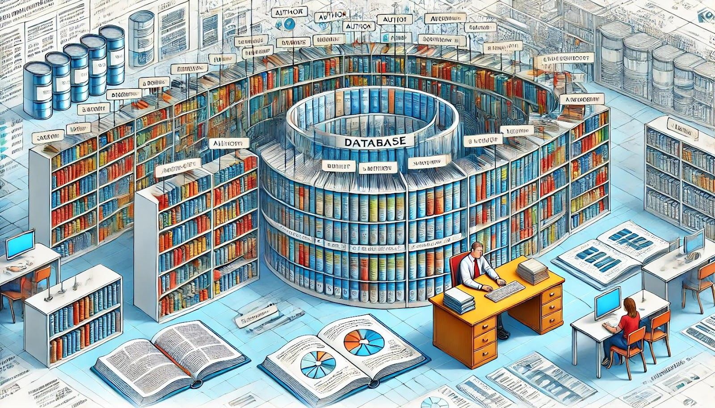
What is a database?
A database is a system designed to store, organize, and manage data. An important feature of databases is that they allow you to store information in a structured form, as well as quickly find the necessary data using queries.

Slide 3
Why databases are necessary?
Advantages of databases:
✅ Support for automatic backup creation
✅ Reliable data storage
✅ Flexibility and convenience when working with large data sets
✅ Efficient information management
✅ Ensuring data availability
Disadvantages of alternative solutions:
❌ Spreadsheet editors struggle with large amounts of data
❌ Files stored on a hard drive make collaboration difficult and can be lost in case of a device failure
❌ Cloud storage is limited when working with heterogeneous data
❌ Managing unstructured data (e.g., in cloud storage) becomes complex and costly

Slide 4
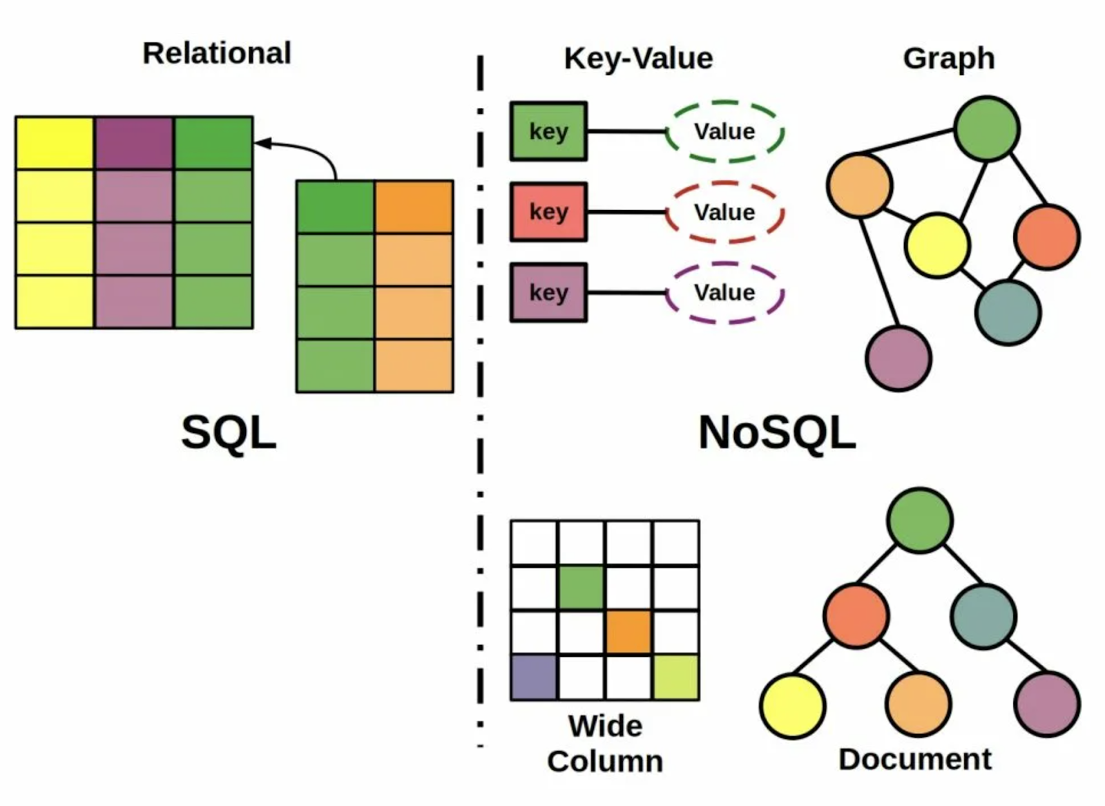
Types of Databases

Slide 5
Relational Databases (SQL)
Primary Key (PK)
Column (Attribute, Field)
Client ID | Name | Surname | Phone number
1 | Aram | Hakobyan | +374 91 123 456
2 | Nvard | Sargsyan | +374 95 234 567
3 | Tigran | Vardanyan | +374 93 345 678
4 | Anahit | Grigoryan | +374 91 456 789
5 | Hovhannes | Petrosyan | +374 94 567 890
6 | Lilit | Abrahamyan | +374 96 678 901
7 | Karen | Melikyan | +374 91 789 012
Row (Tuple, Record)
Cell

Slide 6
Relational Databases (SQL)
Client ID (FK) | Name | Surname | Phone number
1 | Aram | Hakobyan | +37491123456
2 | Nvard | Sargsyan | +37495234567
Primary Key (PK) Foreign Key (FK)
Account ID (PK) | Client ID (FK) | Account type | Balance
101 | 1 | Debit | 1000
102 | 2 | Credit | -500
Transaction ID (PK) | Account ID (FK) | Amount | Date
1001 | 101 | 200 | 01.01.2025
1002 | 102 | -300 | 02.01.2025

Slide 7
Key Terms
Table – A structured collection of data organized in rows and columns within a relational database. Each table represents an entity and consists of records (rows) and attributes (columns).
Row (Tuple, Record) – A single entry in a table, representing a specific instance of the entity. Each row contains values for all columns defined in the table.
Column (Attribute, Field) – A vertical structure in a table that stores a specific type of data for all records. Each column has a name and defines the type of data it holds.
Primary Key (PK) – A unique identifier for each row in a table. It ensures that no two records have the same value in this column or combination of columns.
Foreign Key (FK) – A column or set of columns in a table that establishes a link to the primary key of another table, enforcing referential integrity.
Cell – The intersection of a row and a column, containing a single data value within a table.

Slide 8
Pros and Cons of Relational Databases
✅ Easy to organize and structure data: All data is clearly divided into tables, and their relationships are well-defined.
✅ Data integrity: If a customer cannot have multiple accounts with the same number, the system will prevent such an error.
✅ Powerful queries: With SQL, you can easily retrieve the necessary data, even if it is stored in different tables.
❌ Scalability issues: As your business grows, the amount of data increases, and a relational database may become too slow.
❌ Fixed structure: Modifying the database structure, such as adding a new column or table, can be challenging and time-consuming.

Slide 9
Example of Relational Databases:
MySQL: A popular open-source relational database, widely used for web applications.
PostgreSQL: A powerful object-relational database that supports complex queries and transactions.
Microsoft SQL Server: A proprietary relational database with extensive business and analytics tools.
SQLite: A lightweight relational database embedded in applications, used for local databases.

Slide 10
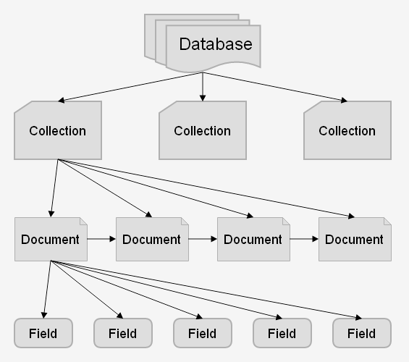
Non-relational databases (NoSQL) Document-oriented databases
Data is stored in the form of documents, usually in JSON format. Example: MongoDB.
{
“client_ID": 1,
"Name": "Aram",
"Surname": "Hakobyan",
“phone_Number": "+37491123456",
“accounts": [
{“account_Id": 101, “Type": “Debit", “Balance": 1000}
]
}

Slide 11
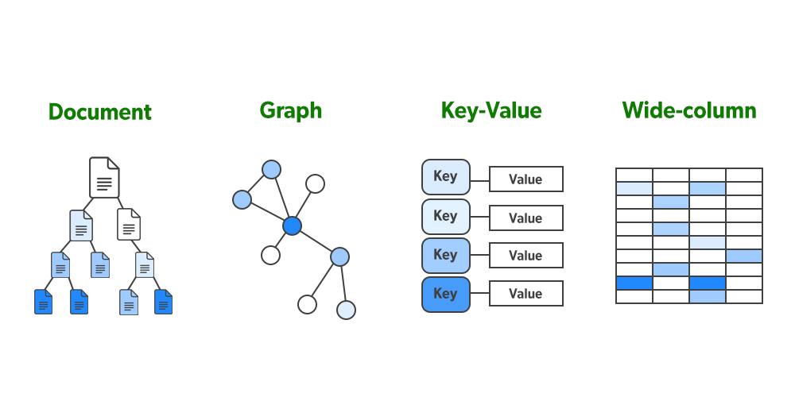
Non-relational databases (NoSQL) Document-oriented databases
Data is stored as key-value pairs (similar to a dictionary).
Example: Redis.
Key | Value
client:1 | {"Name": "Aram", "Surname": "Hakobyan", "phone_Number": "+37491123456"}
account:101 | {"client_ID": 1, "Type": "Debit", "Balance": 1000}

Slide 12
Non-relational databases (NoSQL) Columnar Database
Data is stored in columns, which is efficient for large volumes of data. Example: Cassandra is used for processing data about a large number of users.
Relational Databases (SQL)
Columnar Database (No SQL)
Client ID | Name | Surname
1 | Aram | Hakobyan
2 | Nvard | Sargsyan
3 | Tigran | Vardanyan
4 | Anahit | Grigoryan
5 | Hovhannes | Petrosyan
6 | Lilit | Abrahamyan
7 | Karen | Melikyan
Client ID | Name | Surname
1 | Aram | Hakobyan
2 | Nvard | Sargsyan
3 | Tigran | Vardanyan
4 | Anahit | Grigoryan
5 | Hovhannes | Petrosyan
6 | Lilit | Abrahamyan
7 | Karen | Melikyan

Slide 13
Non-relational databases (NoSQL) Graph databases
Data is stored as graphs with nodes and edges (relationships). Example: Neo4j is used for social networks where users are connected to each other.
Nodes | Edges
Client | { "client_ID": 1, "Name": "Aram", "Surname": "Hakobyan", "phone_Number": "+37491123456"}
Account | { "account_Id": 101, "Type": "Debit", "Balance": 1000}
Relationships
(:Client {client_ID: 1}) -[:HAS_ACCOUNT]-> (:Account {account_Id: 101})

Slide 14
Pros and Cons of Non-relational Databases
✅ Flexibility:
Allows storing different types of data without the need to define a structure in advance.
✅ Scalability: Easily increases system capacity by adding new servers.
✅ Suitable for big data: Handles large volumes of information more efficiently.
❌ Lack of standardization: No universal query language; each type of database has its own specifics.
❌ Limited transaction support: Not all databases follow the ACID principles, which ensure data integrity.

Slide 15
Example of Non-relational Databases:
MongoDB: A document-oriented database that uses JSON-like documents to store data.
Cassandra: A columnar database with high scalability and fault tolerance, suitable for large volumes of data.
CouchDB: A columnar database with high scalability and fault tolerance, suitable for large volumes of data.
Redis: An in-memory key-value database used for fast data access and caching.
Elasticsearch: A database for full-text search and real-time analysis of large data volumes.
Yandex ClickHouse: A columnar database for analytics, optimized for processing large amounts of data in real time with high speed.

Slide 16
Example of Non-relational Databases:
MongoDB: A document-oriented database that uses JSON-like documents to store data.
Cassandra: A columnar database with high scalability and fault tolerance, suitable for large volumes of data.
CouchDB: A columnar database with high scalability and fault tolerance, suitable for large volumes of data.
Redis: An in-memory key-value database used for fast data access and caching.
Elasticsearch: A database for full-text search and real-time analysis of large data volumes.
Yandex ClickHouse: A columnar database for analytics, optimized for processing large amounts of data in real time with high speed.

Slide 17
Differences between SQL and NoSQL:
Criterion | SQL (Relational Databases) | NoSQL (Non-Relational Databases)
Data Structure | Tables (rows and columns) | Documents (JSON, BSON, XML), key-value, graphs, columnar storage
Schema Flexibility | Fixed schema, complex to modify | Flexible schema, does not require strict structure
Data Types | Numbers, strings, dates, etc. | Depends on the database type (text, JSON, images)
Scalability | Vertical (adding more powerful servers) | Horizontal (distributed across clusters)
Compatibility | Requires a strict schema | Flexible schema (new fields can be added dynamically)
Example Databases | MySQL, PostgreSQL, Microsoft SQL Server, SQLite | MongoDB, Cassandra, CouchDB, Redis, ClickHouse
Query Language | SQL (SELECT, JOIN, GROUP BY, ORDER BY, etc.) | Custom query languages (MongoDB Query Language, CQL for Cassandra)
Transactions | Full ACID support | Limited ACID support in most cases
Use Cases | Financial systems, accounting systems (ERP, CRM) | Big Data, analytics, social media, logging

